Slide 1
Empowering SMBs with Enterprise-Level Asset Management
Finally, a comprehensive solution designed to streamline procurement, asset lifecycle management, and more for small and mid-sized businesses.

Slide 2
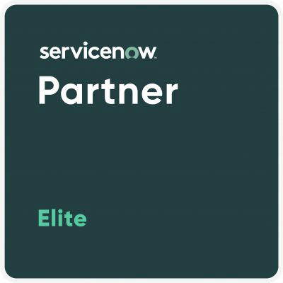
Who is Stave Apps?
For years, Stave has been a trusted leader in enterprise-level asset management, providing innovative solutions that drive eﬃciency and success for large organizations. With our deep expertise in the enterprise space, we’ve now crafted AssetSkout, a powerful, scalable solution speciﬁcally designed for small to mid-sized businesses. By bringing the same level of visibility, control, and optimization to SMBs, AssetSkout enables them to operate with enterprise-level capabilities at a fraction of the cost.
Experts in asset lifecycle management
Extensive experience in enterprise-level solutions
ServiceNow Elite Partner with deep integration knowledge

Slide 3
Streamline Your Asset Lifecycle
Optimize every stage of asset management from procurement to disposal with one intuitive platform
Automate to Accelerate
Reduce manual processes with automated workﬂows for maintenance, procurement, and inventory management
Enterprise Expertise Empowering SMBs
Stave's enterprise-level expertise in asset lifecycle management and procurement has enabled us to design a solution that delivers big business tools and benefits to SMBs.
Enterprise Power, SMB Simplicity
Workﬂows for maintenance, procurement, and inventory management eﬃciency.
Insights for Smarter Decisions
Real-time analytics empower you to make informed choices, maximizing asset eﬃciency and value
Cut Costs, Boost Productivity Streamlined asset tracking and automated processes save time and reduce operational
expenses
Purchasing
Tracking
Reporting & Decision Making
Managing
Centralize procurement and gain visibility into all purchasing activities for cost eﬃciency.
Automate asset management and maintenance to extend asset lifespan and minimize downtime.
Leverage real-time data insights to optimize asset performance and drive smarter business decisions.
Monitor and track assets in real-time to maximize utilization and reduce loss.

Slide 4
A Full range of Features Provided by AssetSkout
Access Global Marketplaces
Centralized Purchasing
Procurement Tracking
Dashboards
User Self-Service
Asset Management
Asset Commissioning
Asset Inventory Management
Condition Based Monitoring
Asset Chain-Of-Custody & Transfer
Warranty Management
Planned Maintenance
Predictive Maintenance
Available Resources
Work Order Management
Workflow And Automation
Fleet Management
Fleet Check-Out & In
Asset Decommissioning
Asset Disposition
Skills Management
What is
AssetSkout is a comprehensive asset lifecycle management solution that empowers SMBs to manage their assets just like the big players. It covers everything from procurement and maintenance to tracking, reporting, and disposition.

Slide 5
Key Features & Capabilities
Asset Lifecycle Management
QR Code Integration
Inventory Management
Global Marketplaces
Maintenance Scheduling
Fleet Management
Warranty Management

Slide 6
Empowering SMBs with Proven Results
Requirements: It must be mobile-friendly, have a modern, natural interface, and be able to scale to other departments.
Requirements: focus on solutions that allowed customization and branding of room signs that incorporate unique QR codes allowing employees to quickly access the facilities database and submit a request for service instantly using mobile devices.
Solution: The elapsed time to complete requirements deﬁnition, design, installation, testing, and launch the mobile responsive portal was less than four weeks.
Solution: Cox utilized Stave’s QRCode Generator to create a track maintenance requests for all conference rooms. Stave delivered a solution in a matter of weeks.
30%
reduction in
phone support
30%
Increased
user adoption
200%
Increase in Digital Maintenance Requests

Slide 7
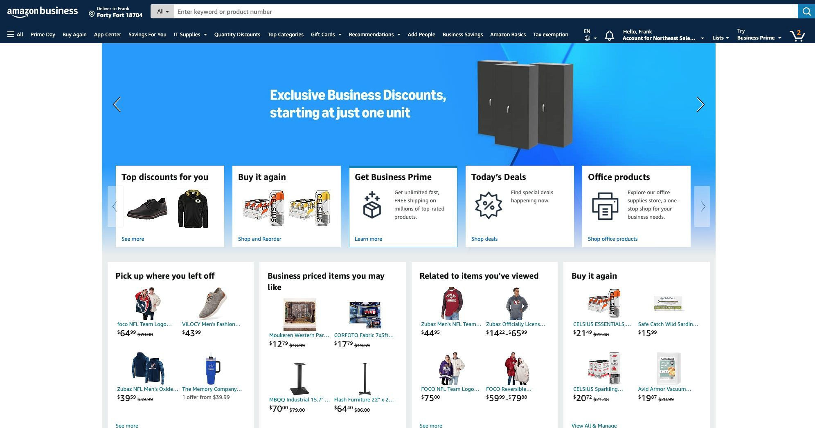
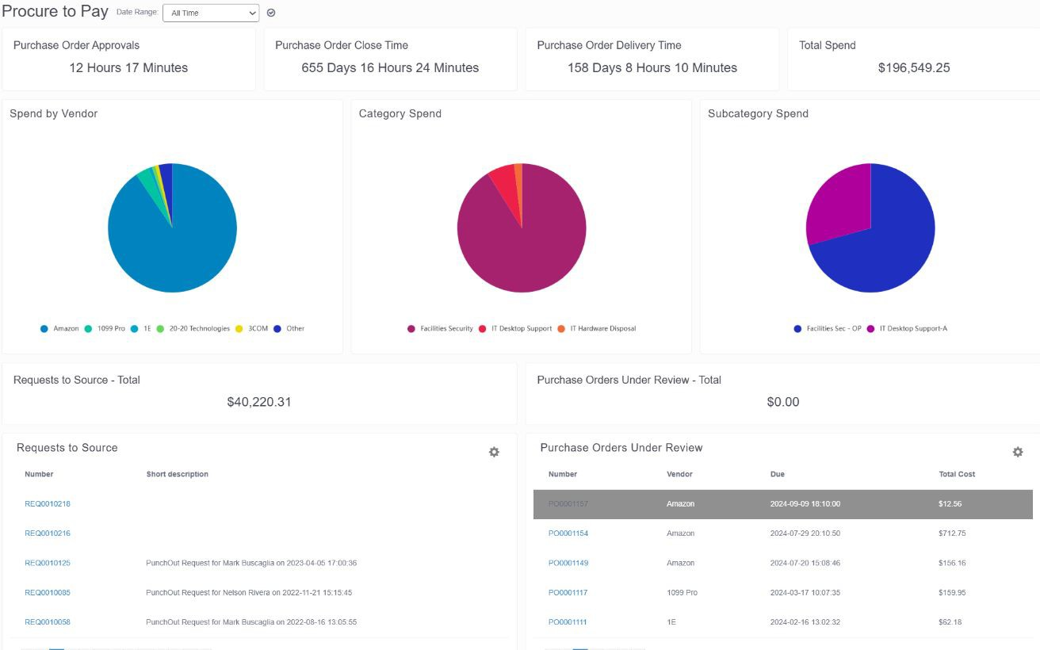
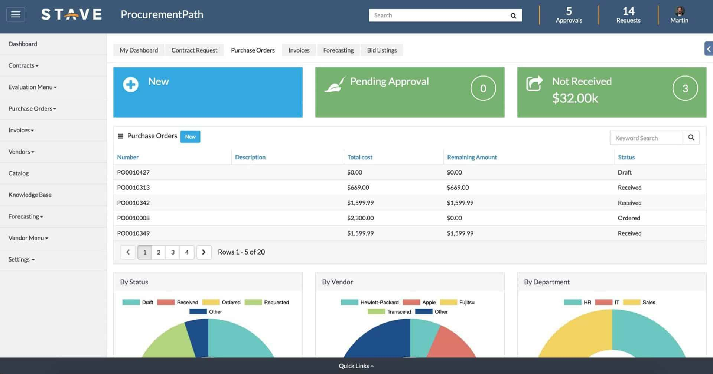
Now Integrated With
With AssetSkout's seamless Amazon Business integration, businesses gain easy access to a global marketplace directly from within the platform. Purchases are tracked, inventoried, and automatically routed to the right channels, eliminating the need for cumbersome spreadsheets. Plus, warranty and maintenance management are automated, ensuring assets are properly maintained throughout their lifecycle, providing total procurement control with effortless accessibility and transparency.

Slide 8
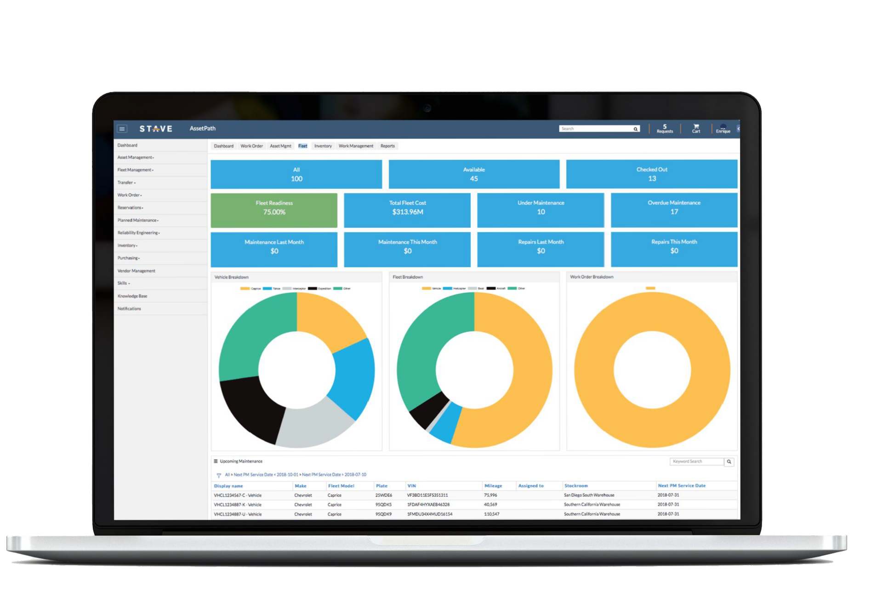
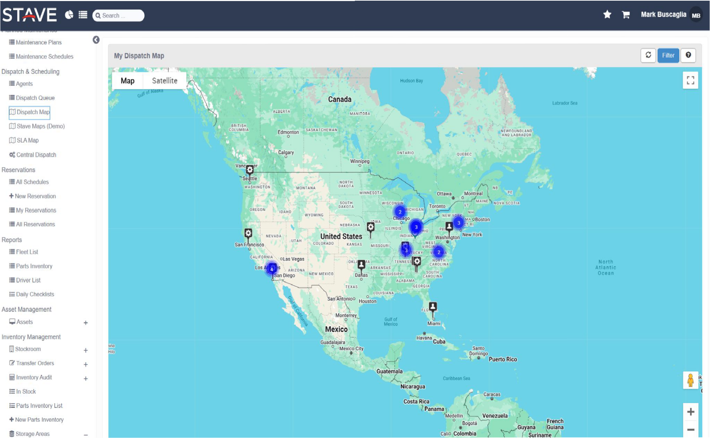
Operate with Intelligence.
Real-Time Tracking & Automation
Gain real-time visibility into your asset fleet, automate routine maintenance, and respond proactively to any issues, all within one seamless platform.

Slide 9
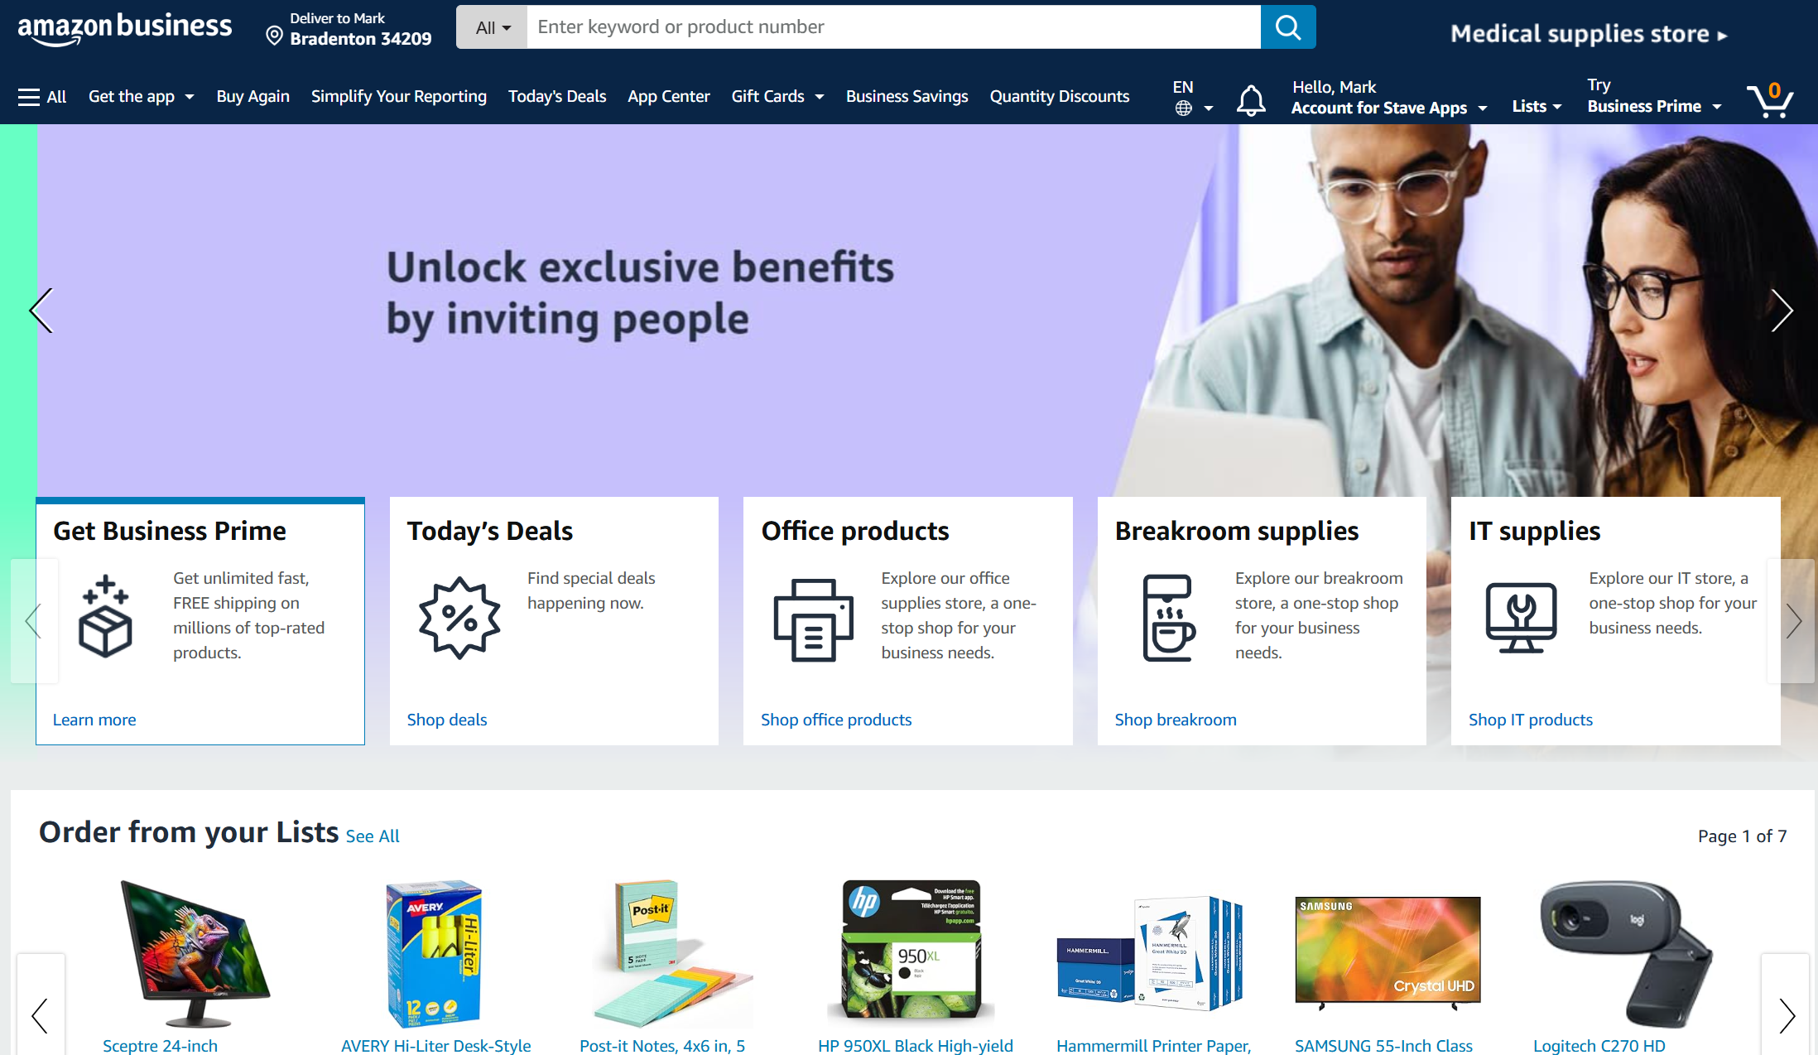
Operate with Intelligence.
Access and Integrate Global Markets
AssetSkout- Smal Business Consumer Value
Stave - Amazon Business – Enterprise Catalog for Small Business via Amazon Business
Vendor Management
Stave/Amazon Business Fulfillment
Marketplace Portal For Business Supplies
ServiceNow Platform for Single View of all purchases

Slide 10
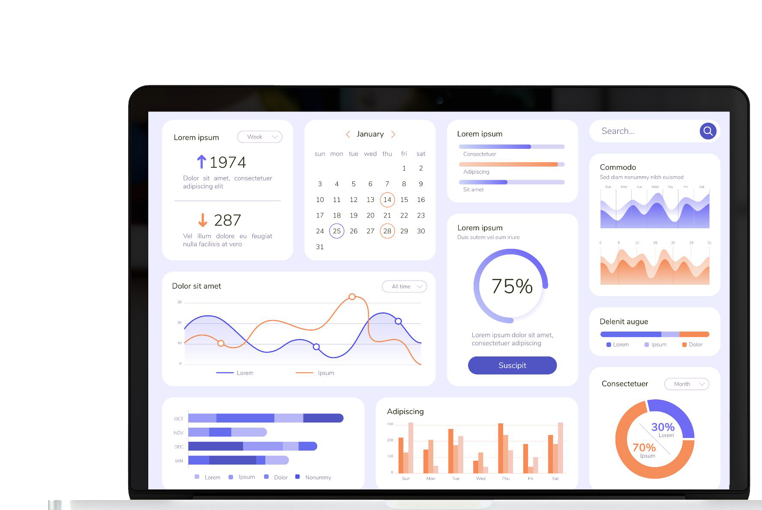
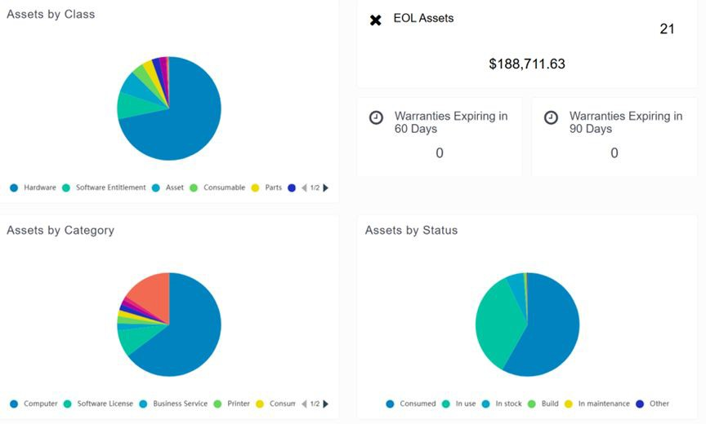
Custom Dashboards & Reporting
SMBs can create custom dashboards to visualize asset performance, inventory levels, and maintenance schedules, providing actionable insights that
drive efficiency.
Analytics
Growth
Productivity

Slide 11
Real Results, Real Beneﬁts
Increased Asset Lifecycle
Improve Productivity
Improve Cost Reductions
Faster Procurement Processes
Increase your eﬃciency exponentially
60%
90%

Slide 13
Architecture One to Many
One ServiceNow Instance | Many Asset Management Solutions
QR Code Integration
Inventory Management
AssetSkoutSMB (<5,000 Employees)
Stave Buy It- Amazon Business
Stave Procurement Manager
Stave Asset Manager
Stave Fleet Manager
Stave Maps
Stave QR Code
Stave Core
AssetSkout Enterprise (Current & Non- Current SN Subscribers > 5,000 Employees)
AssetSkoutSMB
Stave Cyber Manager
Data Tools
AssetSkout Enterprise Plus
AssetSkoutSMB
AssetSkout Enterprise
Stave Normalization
AssetSkout Management Functions
Sourcing
Procurement Lifecycle Management
Vender Management
Warranty Management
Technology Inventory Management
Fleet- Enterprise Inventory Management
Inventory Maintenance Tracking
Inventory Work Order Tracking
Asset Commissioning- Decommissioning
Asset Provisioning and Prioritization
QR Code Generation
Location Mapping
Operational Security
Risk & Value Rationalization
Auditable Workflow for Asset Lifecycle

Slide 14
AssetSkout Implementation Pricing
Package Name | Essential Launch (OOTB) included | Growth Accelerator ($5,800) * | Enterprise Transformation
High Level Inclusion | - Out of the Box Application Setup | Essential Launch functions, + - Advanced field types - Moderate Scripting - Business rules - Workflow design - approvals - notifications - Email notifications | Growth Accelerator functions + - Custom UI elements - API integration - Other Application integrations (Need Scope)
Features
Stave App Setup | Basic Stave app setup | Comprehensive Stave app setup | In-depth Stave app customization
Workflow Implementation | Up to 3 core workflows configured | Up to 5 complex workflows configured | Custom workflow development and implementation
Roles & Permissions Setup | Essential user roles and permissions established | Detailed user roles and permissions configured | Granular user roles, permissions, and access controls
Integrations | N/A | Integration with 1 existing system | Integration with multiple complex systems
Training | Basic Stave app and ServiceNow user training | Comprehensive Stave app and ServiceNow admin & user training | Enterprise-level Stave app and ServiceNow admin & user training
Reporting | Basic reporting configuration for pre-built (OOB) Stave dashboards | 2 Custom dashboards with drill-down capabilities | Advanced reporting configuration with custom reports and data visualizations
Support | Bronze Support Package | Silver Support Package | Platinum Support (24 X 7)
QR Code Integration
Inventory Management

Slide 15
AssetSkout Implementation
Stage | Actions Included | Package Name
Discovery & Planning | * Gather requirements (i.e. procurement, inventory, and risk management needs) | All Packages
 | * Define user roles and access permissions. | All Packages
 | * Identify the system for integration. | All Packages
 | * Schedule training sessions. | All Packages
Stave App Configuration | * Configure core Stave app modules for purchase orders, vendor management, and basic stock control. | Essential Launch
 | * Set up essential data fields and workflows. | Essential Launch
Workflow Implementation | * Develop and configure a limited number of workflows (e.g., purchase order approvals, vendor onboarding, inventory reordering). | Essential Launch
 | * Test and refine workflows for optimal functionality. | Essential Launch
User Roles & Permissions | * Create essential user roles (e.g., Buyer, Approver) with basic permissions aligned with their designated tasks. | Essential Launch
 | * Assign users to appropriate roles within the Stave app. | Essential Launch
System Integration | * Establish a basic integration between Stave and your chosen system (e.g., ERP). | Growth Accelerator, Enterprise Transformation
 | * Configure data mapping for seamless data exchange. | Growth Accelerator, Enterprise Transformation
 | * Test the integration to ensure data consistency. | Growth Accelerator, Enterprise Transformation
Training & Knowledge Transfer | * Conduct introductory training sessions for your team on Stave app functionalities and ServiceNow navigation. | All Packages
 | * Provide training materials and resources for ongoing reference. | All Packages
Go-Live & Support | * Launch the Stave app on ServiceNow for your team's use. | All Packages
 | * Provide a limited number of post-implementation support tickets for initial troubleshooting. | All Packages
QR Code Integration
Inventory Management

Slide 16
Ready to Grow Up?
Book a Demo Today!
Contact our sales team at sales@staveapps.com

